Slide 1
Water Delivery: More Than Turning a Valve
November 1, 2018

Slide 2
Columbia Basin Project
Authorized for power and irrigation in 1943
1,029,000 acres authorized for irrigation
694,000 irrigated acres
Pump on average 2.9 maf from Lake Roosevelt to Banks Lake
Quincy Groundwater Subarea and Potholes Bank Storage

Slide 3
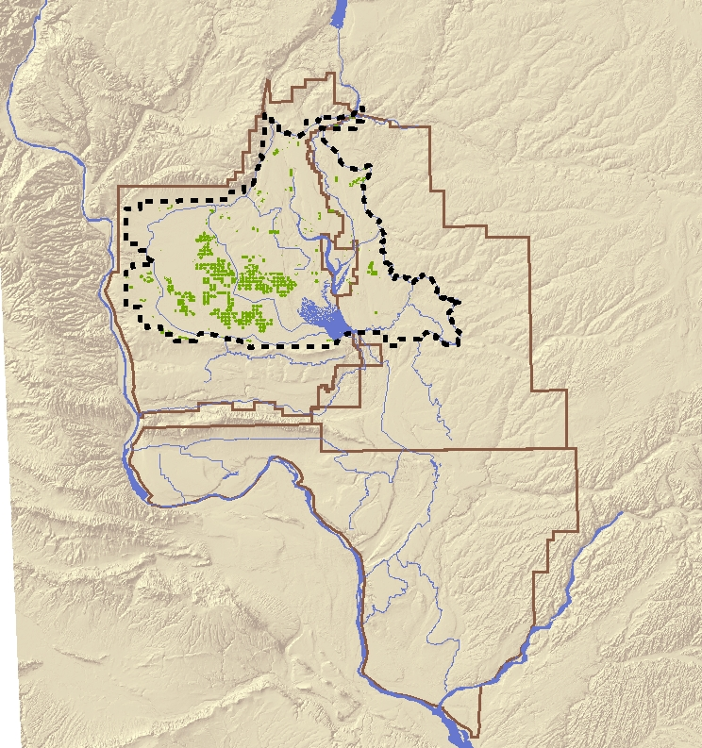
Quincy Groundwater Subarea
Program established in 1975
Jointly administered program
Near full allocation - 173,893/177,000 af
2018 QB Groundwater Rates
Ag $76.18 ac
Non-ag $31.28 a/f
Potholes Bank Storage Program
Within the QGWSA Boundary
Administered by Reclamation
QGWSA

Slide 4
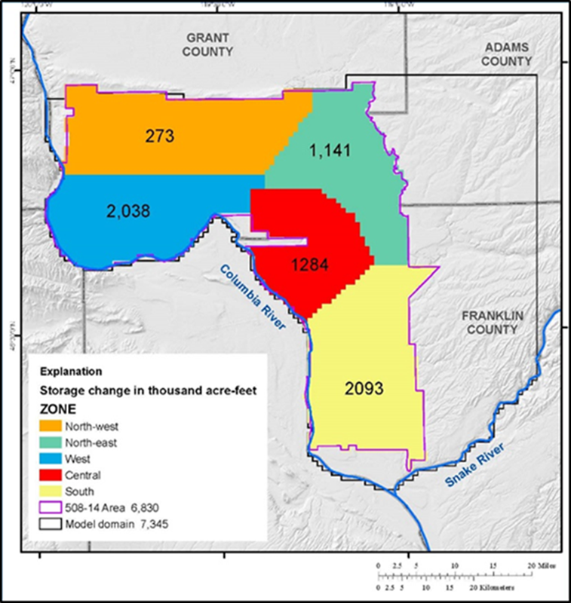
Pasco Basin Groundwater Management Program
~6.8 million acre-feet of groundwater in storage
Next Steps:
Establish a Declaration of Claim – Federal ownership
Develop a joint groundwater program Ecology – Reclamation
Supply and manage Federal groundwater for current and future uses (agricultural and nonagricultural)
Geographic zones with total change in groundwater storage (pre-Project and 2013; Heywood et al, 2016)

Slide 5
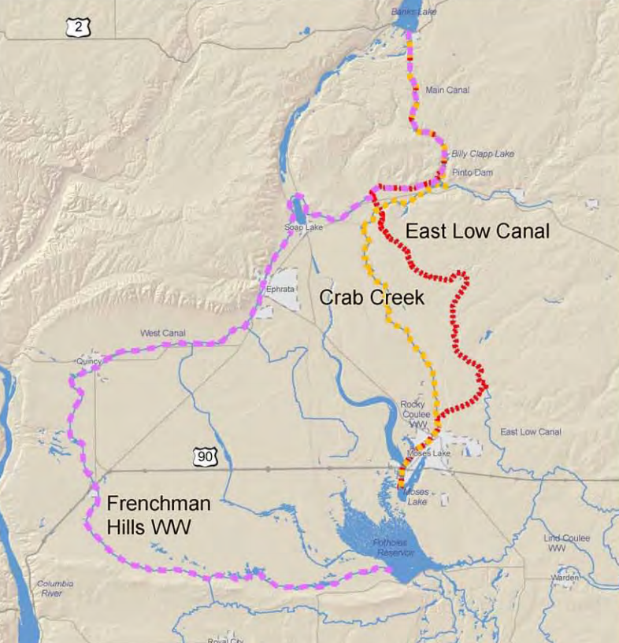
Potholes Supplemental Feed Routes
Supplemental supply for SCBID through Crab Creek and the Frenchman Hills Wasteway
No releases through Crab Creek since August 2016
Unanticipated groundwater flooding in Crab Creek during pilot year

Slide 6
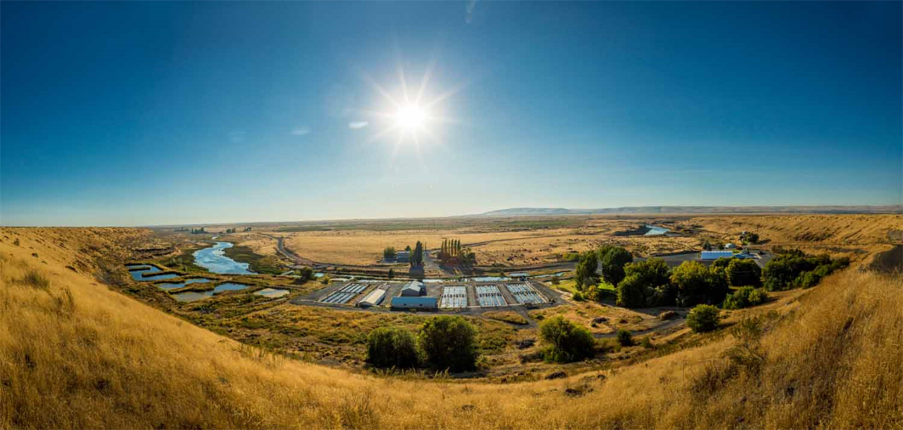
Potholes Supplemental Feed Routes
Troutlodge Hatchery Bypass
Contracted with Reclamation’s Technical Service Center (TSC) to develop bypass solution
Moses Lake International Airport
Elevated water table is impacting airport activities
Collaborating with stakeholders to address issues
Realty Actions
Continuing a number of realty acquisitions and easments
Troutlodge Hatchery

Slide 7
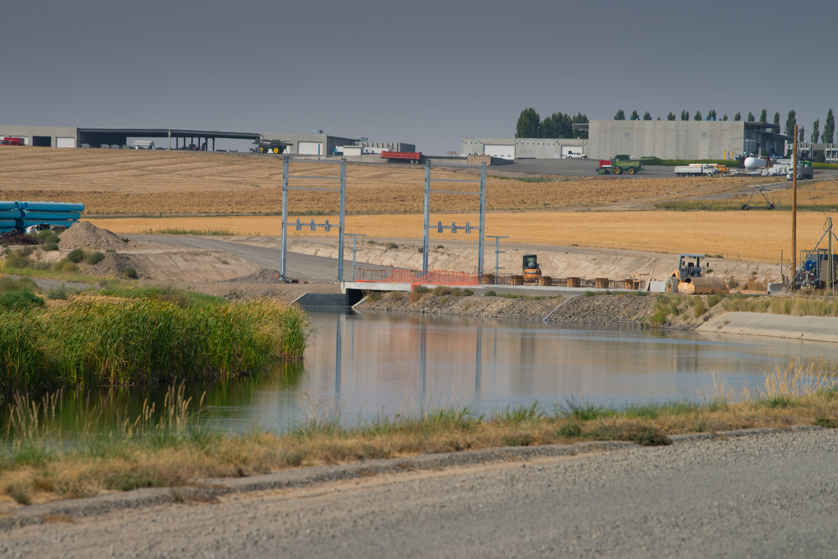
Odessa Groundwater Replacement Program
Major Components
RMWSC
Easements Acquisitions
Land classifications
Supplemental environmental reports
Construction Oversight
Design assistance
Acceptance of title and transfer of O&M

Slide 8
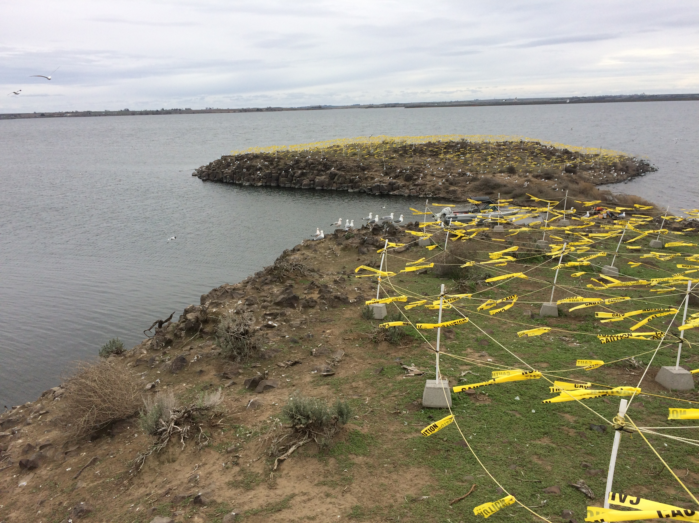
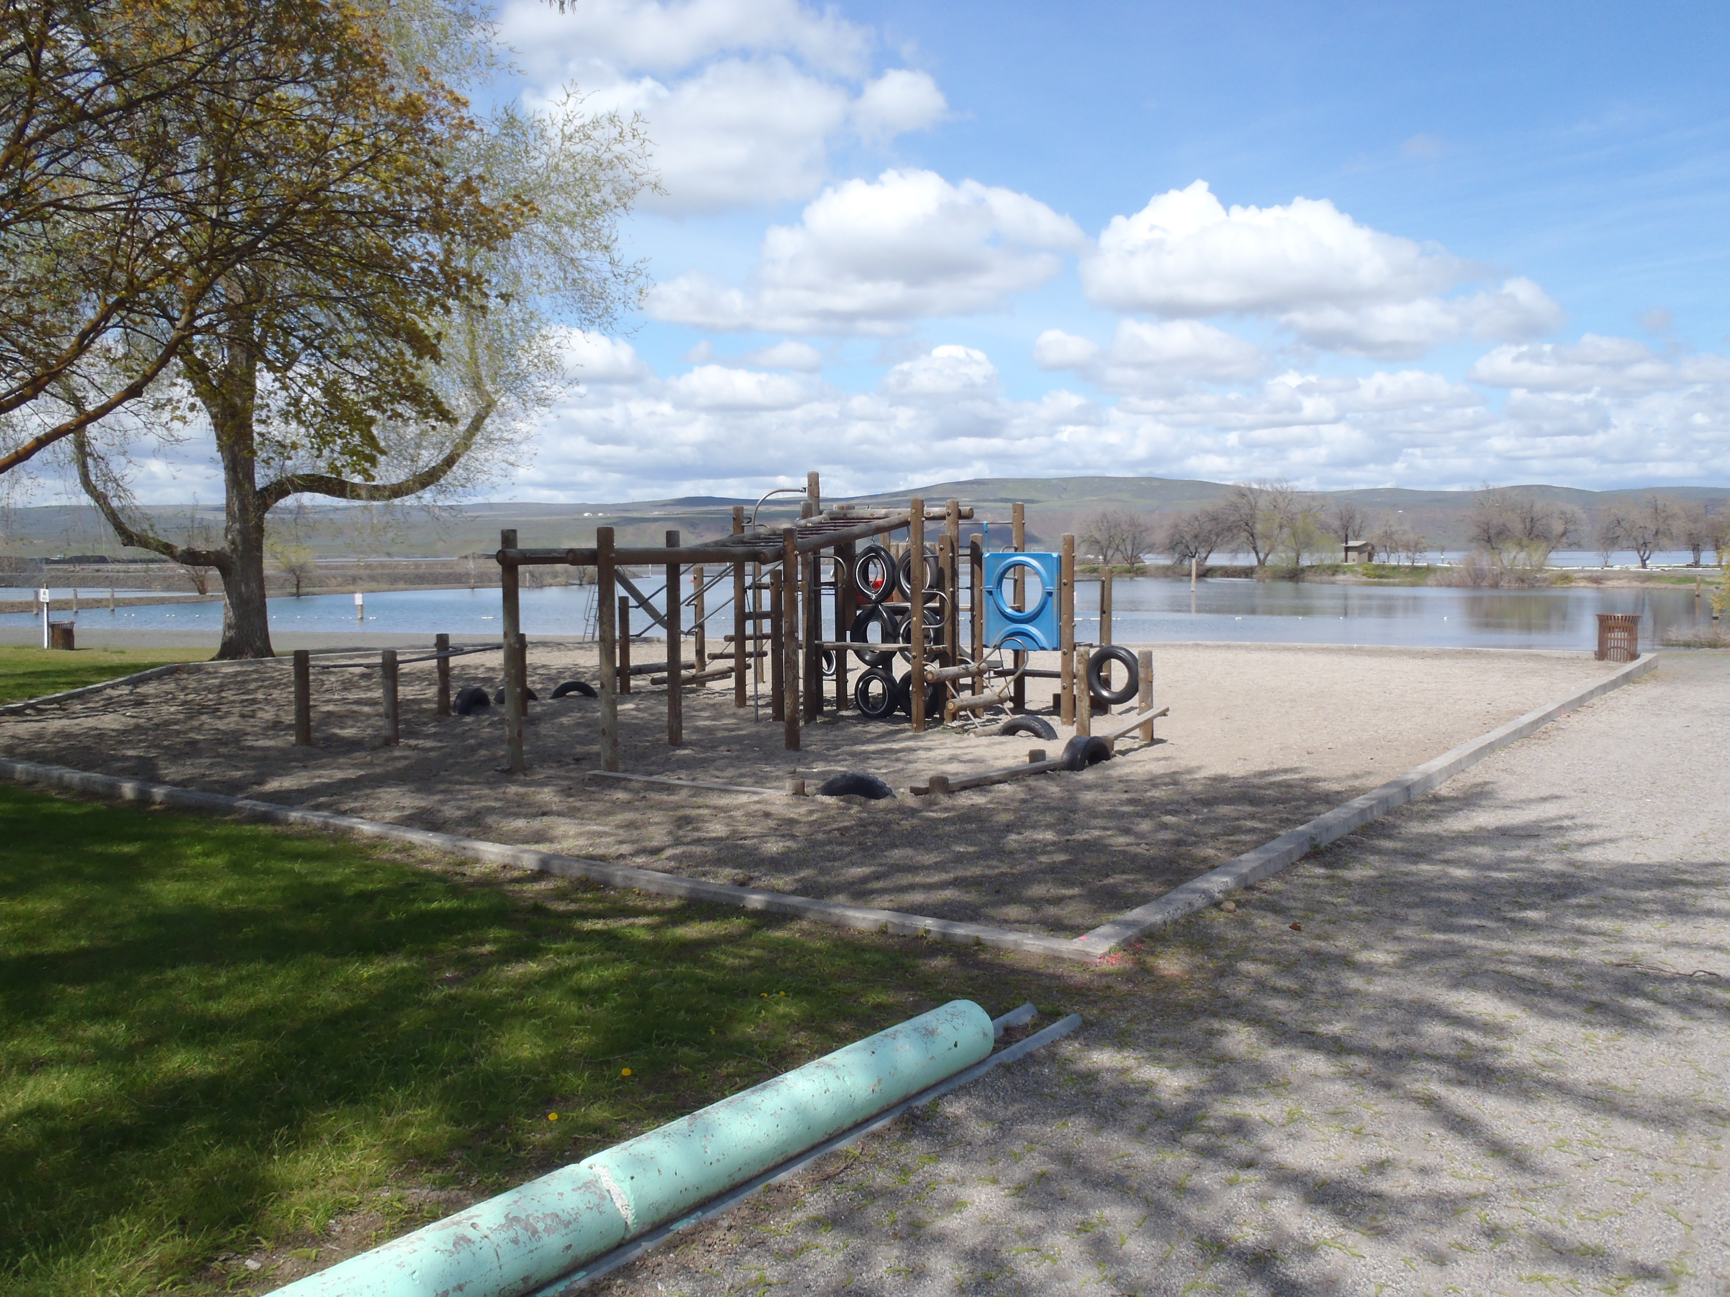
CBP Resource Management
Environmental Compliance
Cultural Resource Compliance
Endangered Species
Water Quality
GIS
Recreation Management
Range Management
Soil Conservation
Land Reclassification
Invasive Plants & Animals
Hazardous Material Surveys

Slide 9
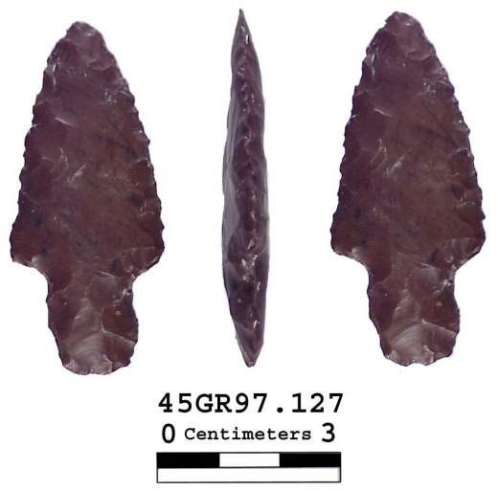
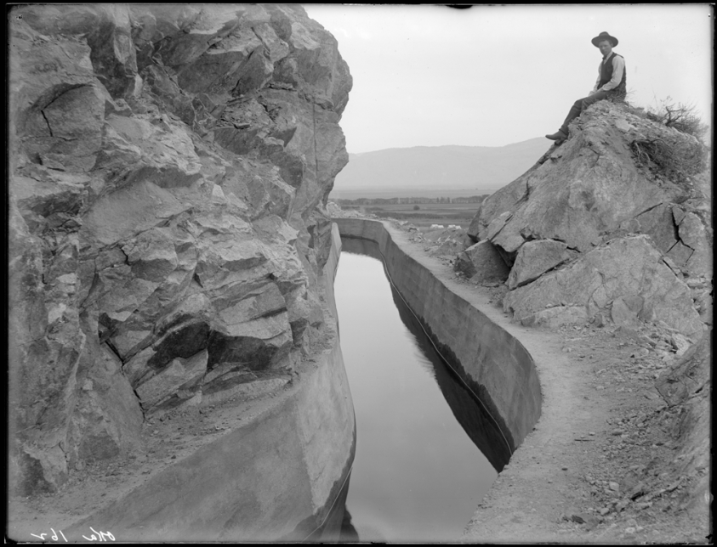
Programmatic Agreement (PA) to comply with the National Historic Preservation Act
A PA is appropriate for long-term projects such as the CBP
Will provide exemptions for actions that normally require consultation
Allows projects to move forward at the same time as mitigation
Multiple parties (Tribes, State and Irrigation Districts) to the PA; includes public involvement

Slide 10
Recreation Management
Directly Managed:
Scooteney Recreation Area
Summer Falls Park
Black Rock Recreation Area
Managed via Partnerships:
Steamboat Rock State Park
Potholes State Park
Conconully State Park
Coulee City Recreation Area
GCPUD Recreation Areas
Dispersed Washington Department of Fish & Wildlife Sites
Four Concessioner Resorts

Slide 11
Water Operations
System Operator
Support CBP projects
Hydrologic Forecasting
Hydrography Management (tracking/accounting of water)
Emergency Action Plan development and response
Flood operations

Slide 12
2018 Diversions
 | Location | Yearly Total | % Avg*
Diversions (acre-feet, excluding feed in West and East Low Canals) | Main Canal | 2,587,230 | 94%
 | East Low Canal | 996,450 | 99%
 | West Canal | 1,352,010 | 97%
 | Potholes East Canal | 892,200 | 94%
Feed (acre-feet) | Crab Creek | 0
 | Lind Coulee WW | 41,260 | 103%
 | Rocky Coulee WW | 105,760 | 46%
 | Scooteney WW | 0
 | Frenchman Hills WW | 40,748 | 106%
 | Winchester WW | 5,542 | 76%
*% average based on the previous 5 years of diversions (2013-2017)

Slide 13
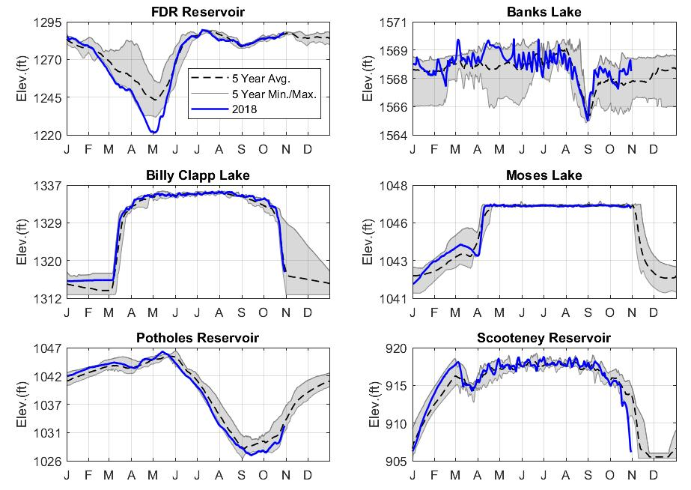
2018 Reservoir Operations

Slide 14
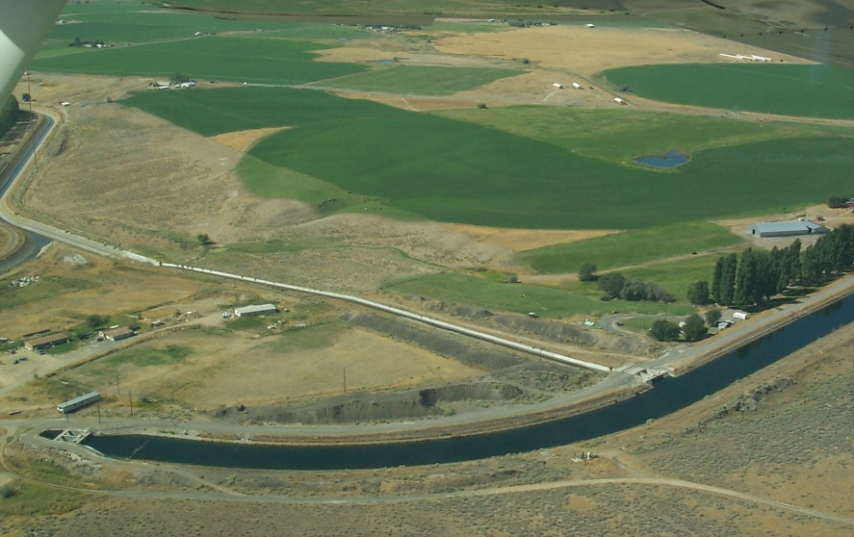
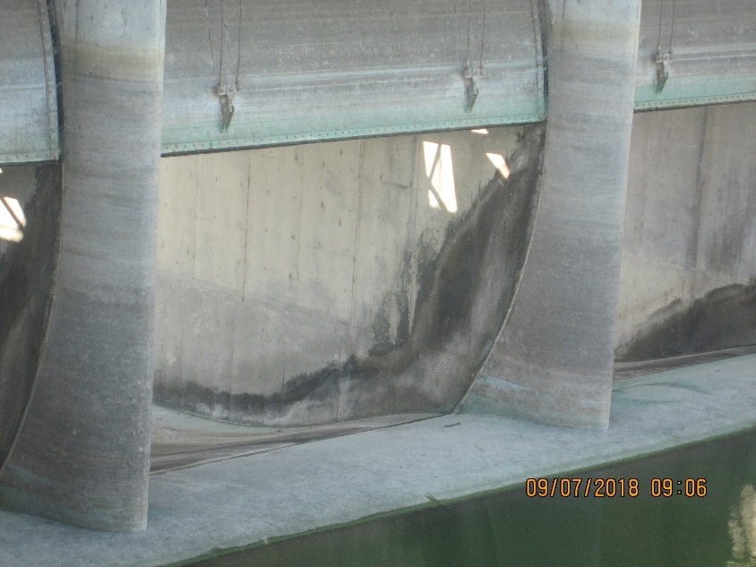
2018 Feed Program
2018 total feed was 58% of average
Feed through Rocky Coulee, Lind Coulee, Winchester, and Frenchman Hills Wasteways
Potholes Reservoir reached full pool on May 14
Drafted Potholes Reservoir in September to perform spillway gate inspection
Rocky Coulee Wasteway
O’Sullivan Spillway, 2018

Slide 15
Grand Coulee Graveyard and Swing Shift Transition
Graveyard and swing monitoring shift transitioned from EFO to Grand Coulee Power Office (GCPO)
Operator duty remains at EFO
Technology infrastructure (i.e., computer, phone, radio)
GCPO staff trained through classroom and on-the-job experience in early 2018 water season
Officially transitioned monitoring duties in August 2018

Slide 16
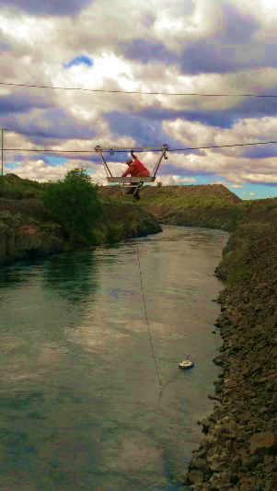
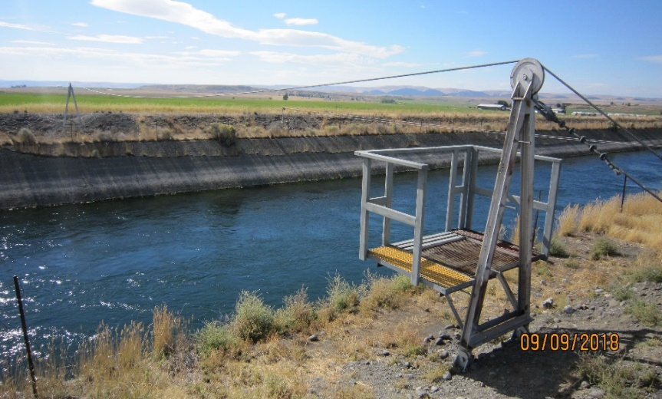
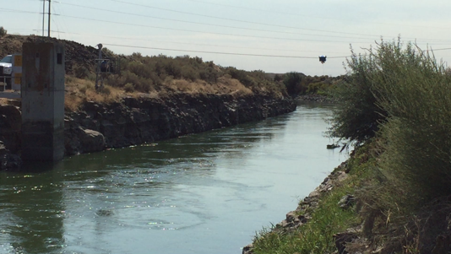
Safety Improvements
Decommissioned cable cars
Added in-canal ladders downstream of gaging stations
Repaired/replaced buoys
Purchased new air monitors for confined space entry
Certified fall protection equipment
Trained staff in confined space entry, lock out/tag out, boat operation, fall protection, and first aid

Slide 17
Supervisory Control and Data Acquisition (SCADA)
Maintain and modernize SCADA system
Oversee and perform security and upgrades to system
Coordinate with Districts
Maintain SCADA computers for Reclamation and Districts
Administer SCADA access
Provide 24/7 on-call duty to support Operations staff

Slide 18
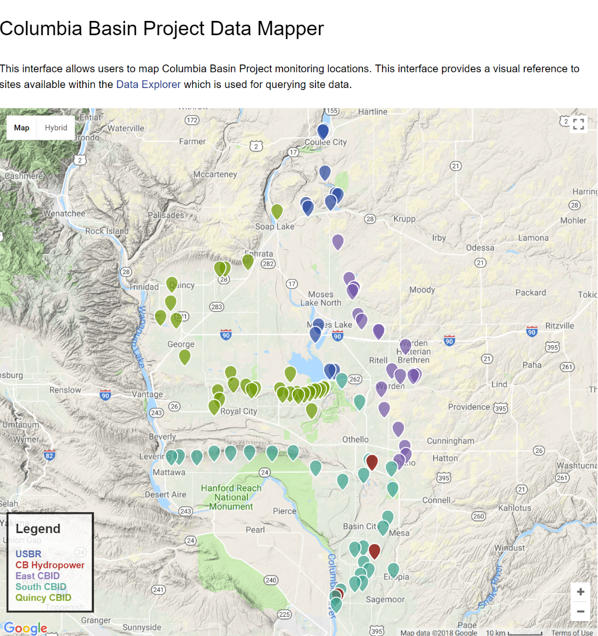
SCADA Website
New Reclamation-hosted website
Enhancements
No log-in or password required
All alarms included (pump, communication failures, etc.)
Added power plant alarms at request of CBHP
Includes map with interactive points
Under Development
Set points
Flow
History
https://www.usbr.gov/pn/hydromet/cbp/

Slide 19
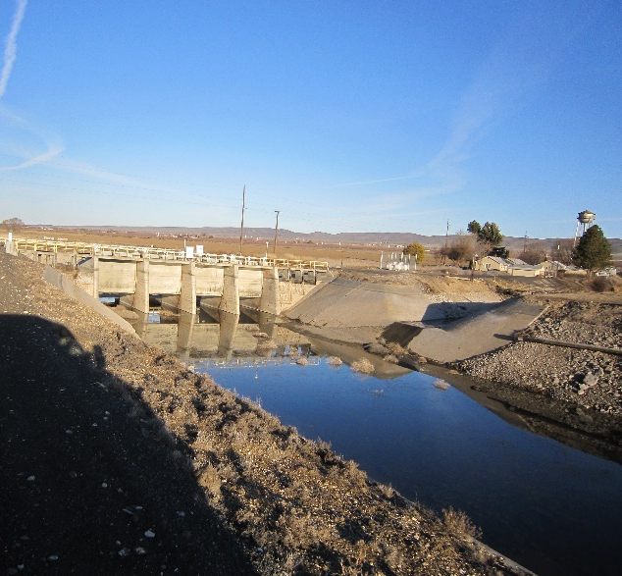
West Canal Tier II Analysis
TSC completed a Tier I screening of 231 canal sections throughout Reclamation
TSC selected West Canal near Quincy for a more detailed Tier II analysis in 2018-2019
Develop potential failure modes under static, seismic and hydrologic loading conditions
Estimate consequence levels and likelihoods
Identify areas that pose highest risk

Slide 20
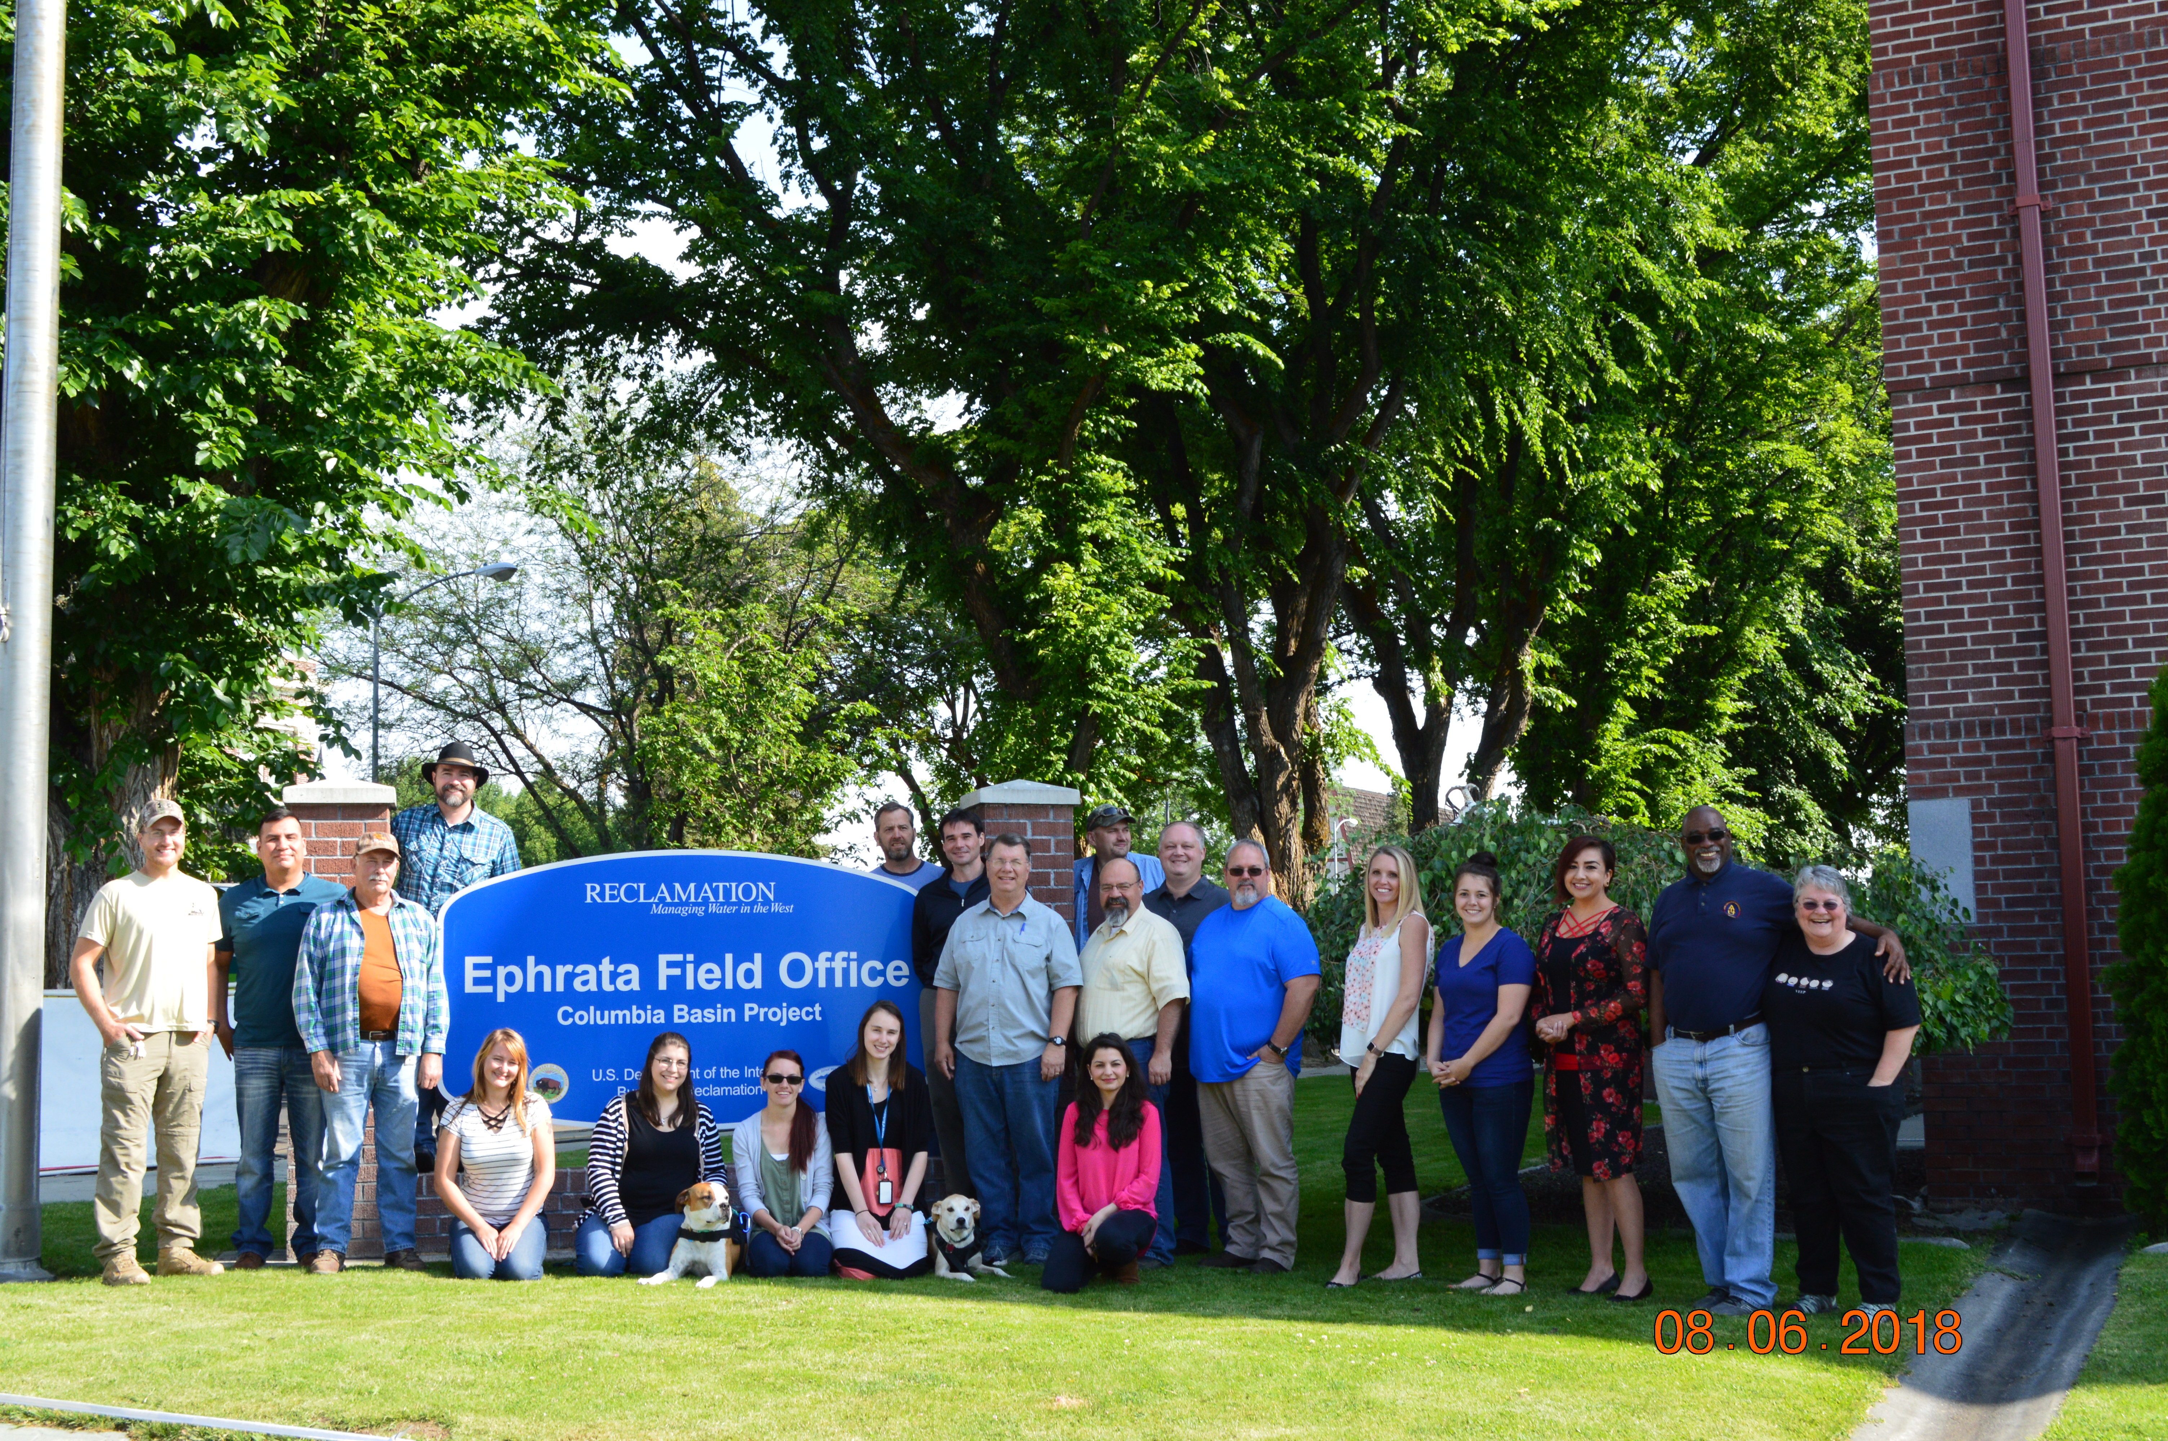
Amazing People Doing Important Work

Slide 21
Questions?
Marc Maynard
Ephrata Field Office Manager
Bureau of Reclamation
509-754-0214
mmaynard@usbr.gov

