Slide 1
PPL1.6 Pumping Plant Project Overview
John O’Callaghan, Assistant Manager, Technical Services
South Columbia Basin Irrigation District

Slide 2
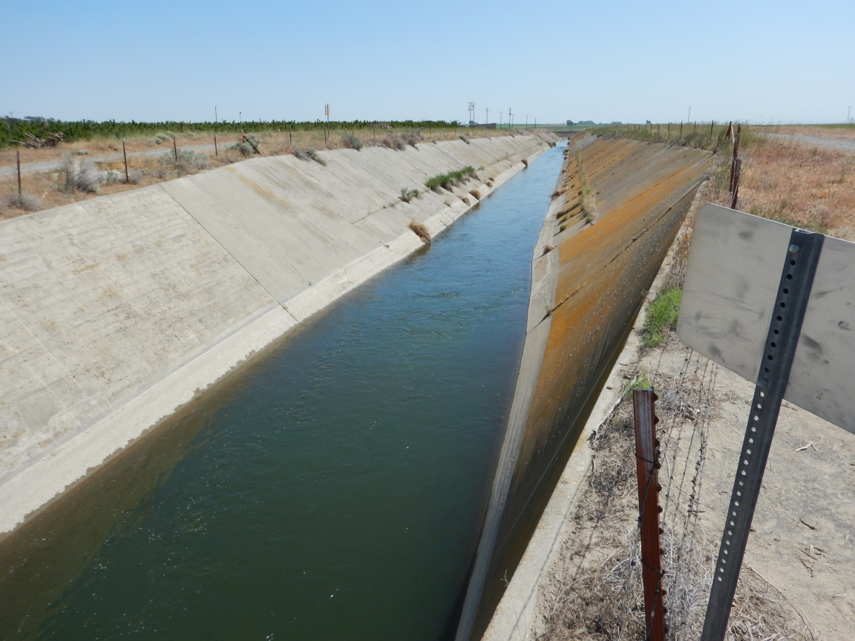
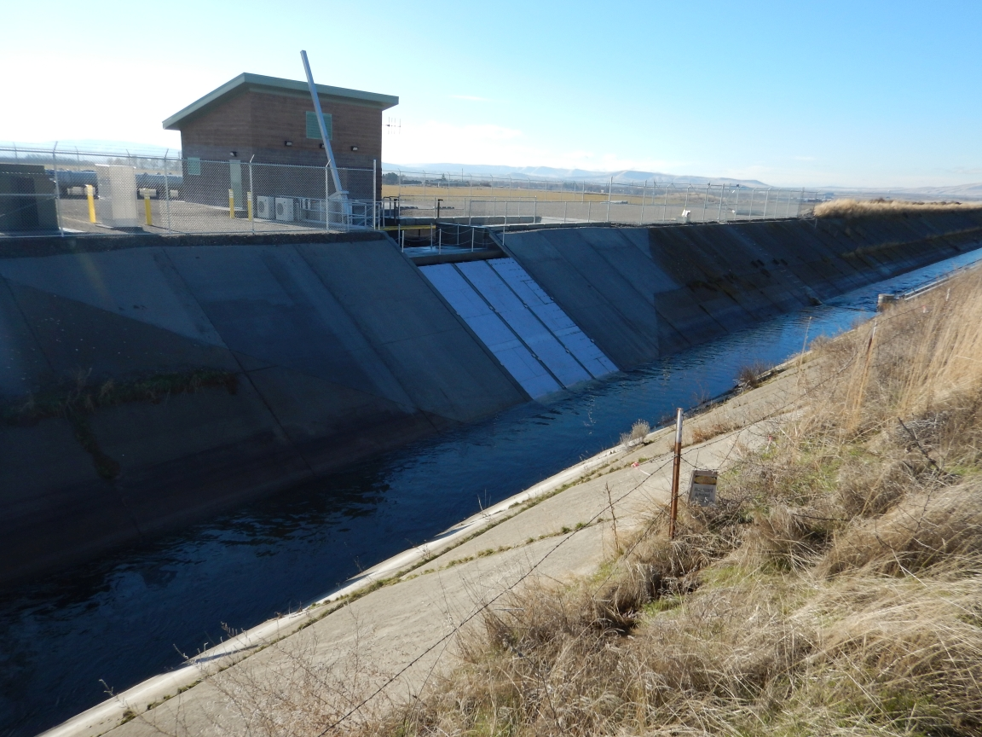

Slide 3
Description
The PPL1.6 Pumping Plant lifts waste, seepage and return flow project water, which would otherwise be lost to the Columbia River, from the Esquatzel Diversion Canal up into the Pasco Pump Lateral, serving irrigation demand for Block 1.

Slide 4
Summary
Engineering and Construction Services
RH2 Engineers, Richland, Washington
General Contractor
Apollo, Inc., Kennewick, Washington
Bureau of Reclamation
Engineering Review and Approval
NEPA & NHPA Compliance
Total Cost to Date - $5,032,484

Slide 5
Benefits
Irrigation Water Supply
Block 1 supply during peak demand
Increase available supply upstream during peak demand
Operational
Reduces stress and demand on upstream system
Provides operational flexibility during aquatic herbicide applications in the lower Potholes Canal

Slide 6
Benefits (cont)
Conservation
Potential reuse in excess of 30,000 acre-feet of project waste, seepage and return flow
Terminal System Management
Allows for enhanced operational response to downstream issues in an urbanising, high risk service area

Slide 7
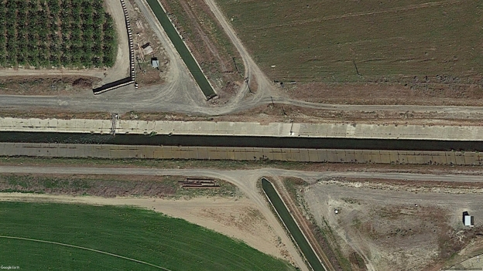
Site – Pre Construction

Slide 8
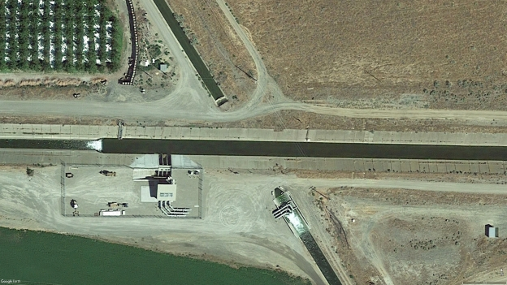
Site – Post Construction

Slide 10
Timeline

Slide 11
Timeline and Milestones
SCBID Letter of Intent sent to Reclamation
06/26/2008
BPA Incentive Payment
Application – 08/27/2015
Agreement Signed – 10/23/2015
Amount of $1,526,425

Slide 12
Timeline and Milestones (cont)
Reclamation Memorandum of Agreement
Signed – 02/17/2016
Engineering – RH2 Engineering
Professional Services Agreement – 12/07/2015
Amendment #1 – 05/19/2016
Amendment #2 – 11/21/2016
Amendment #3 – 11/21/2016

Slide 13
Timeline and Milestones (cont)
Physical Model Development
Northwest Hydraulic Consultants
Model Test Runs – 07/2016
Final Report – 09/09/2016
Apollo Inc. Contract
Contract Executed – 12/20/2016
Limited Notice to Proceed – 12/27/2016
Full Notice to Proceed – 01/23/2017

Slide 14
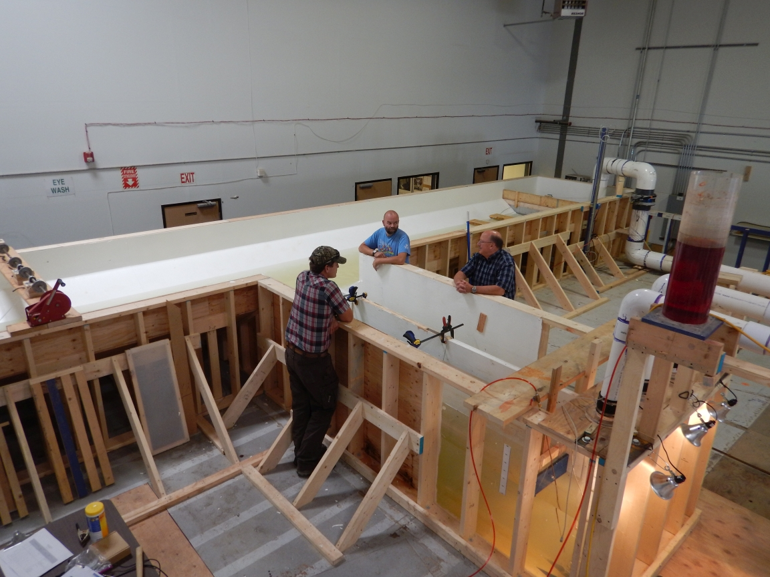
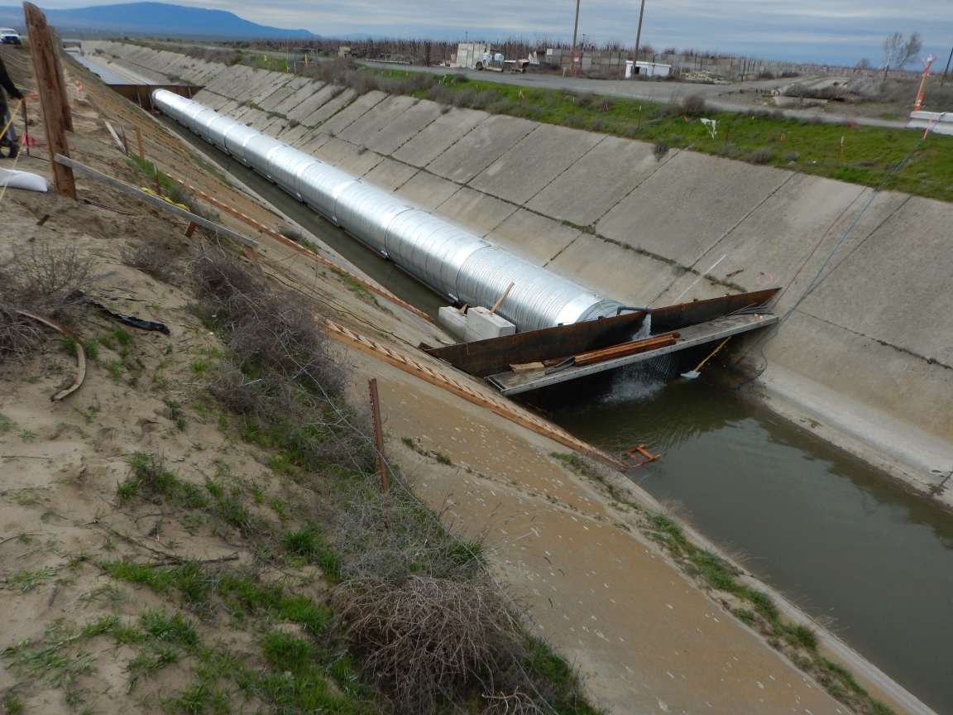
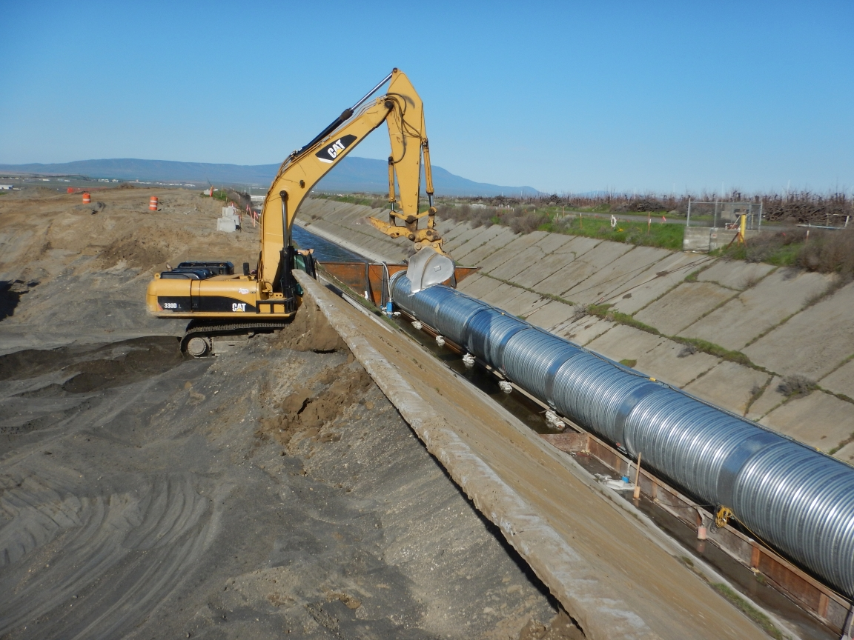
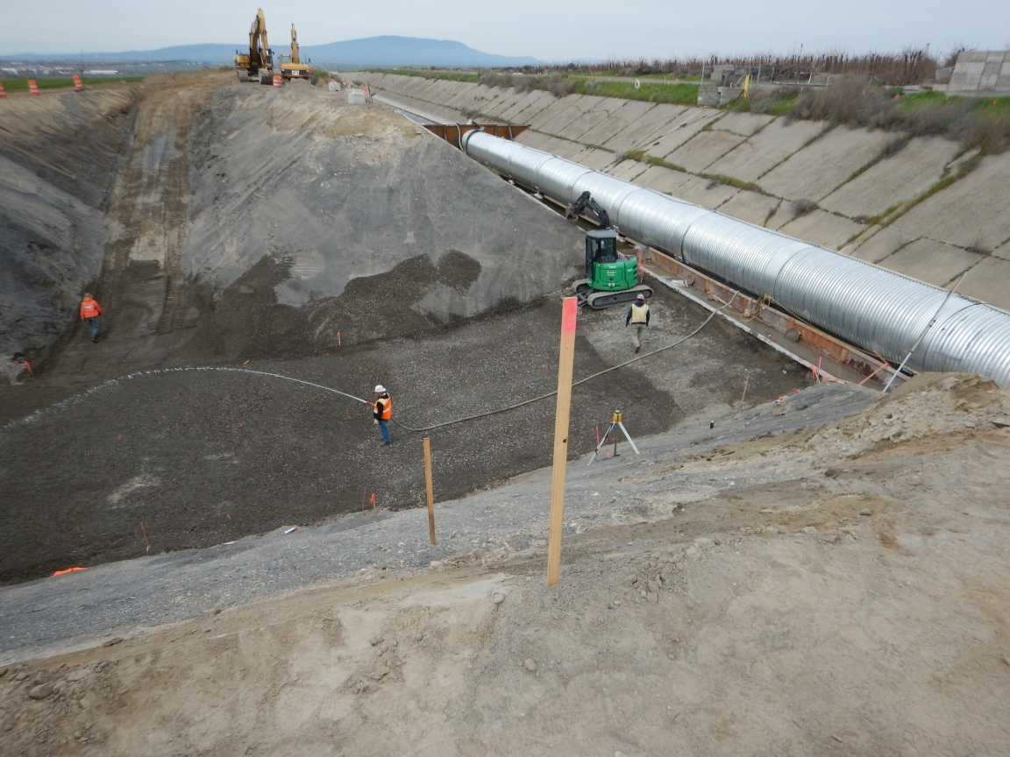

Slide 15
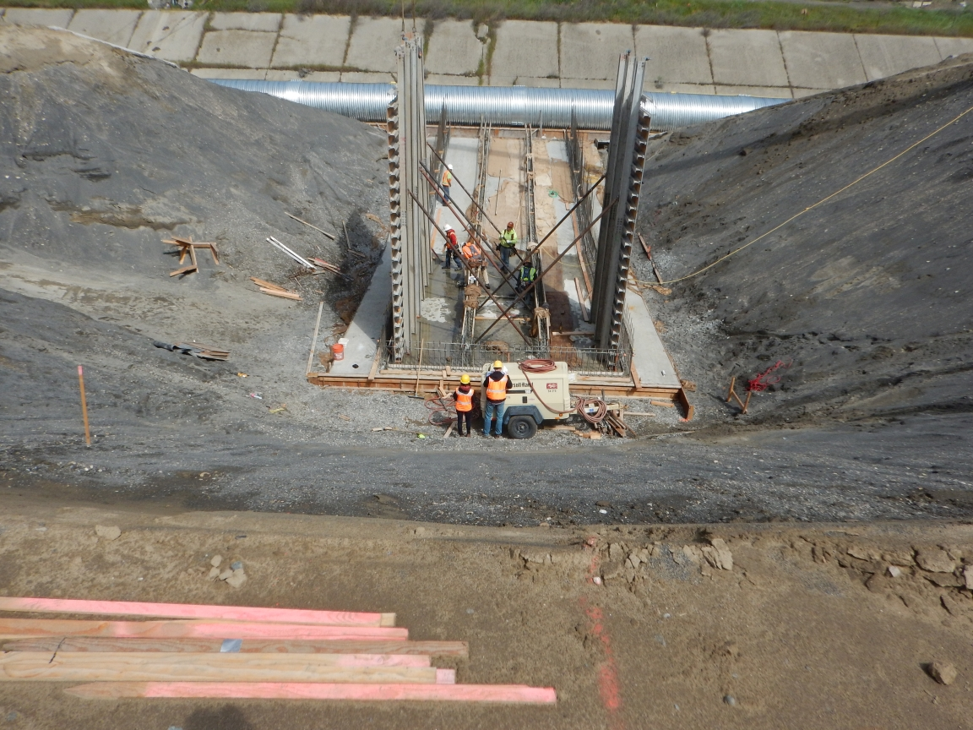
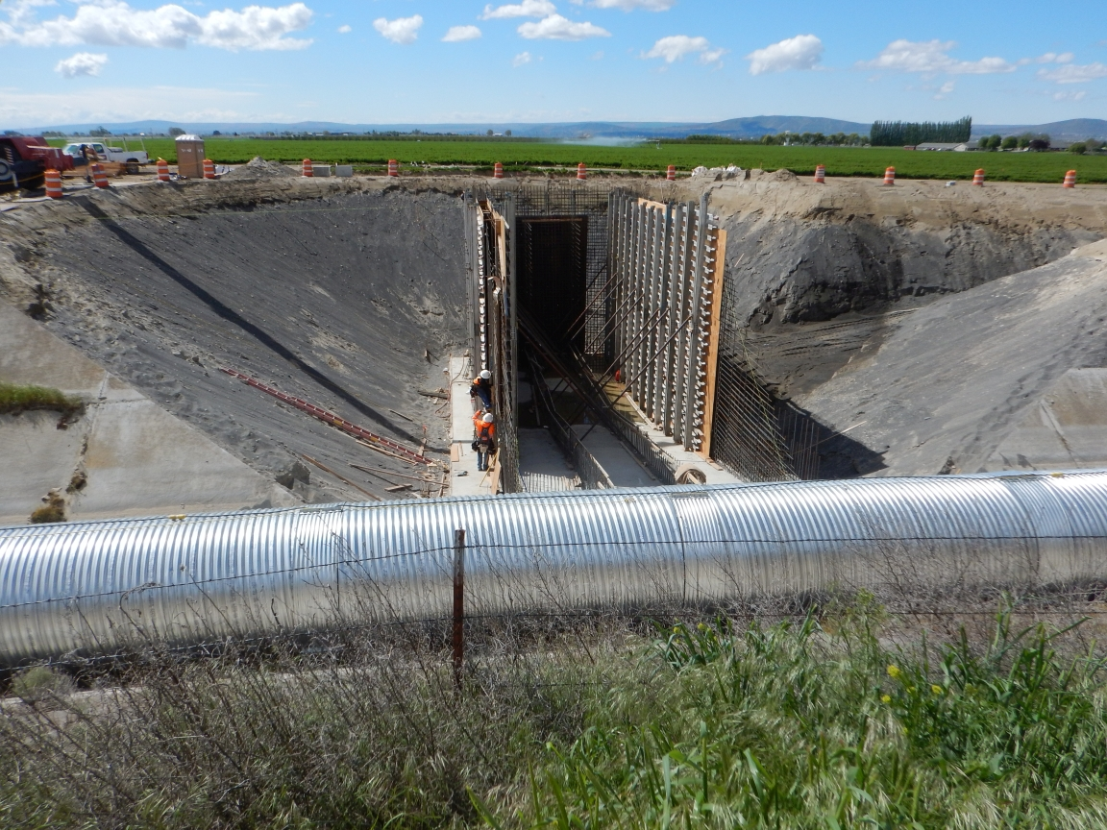
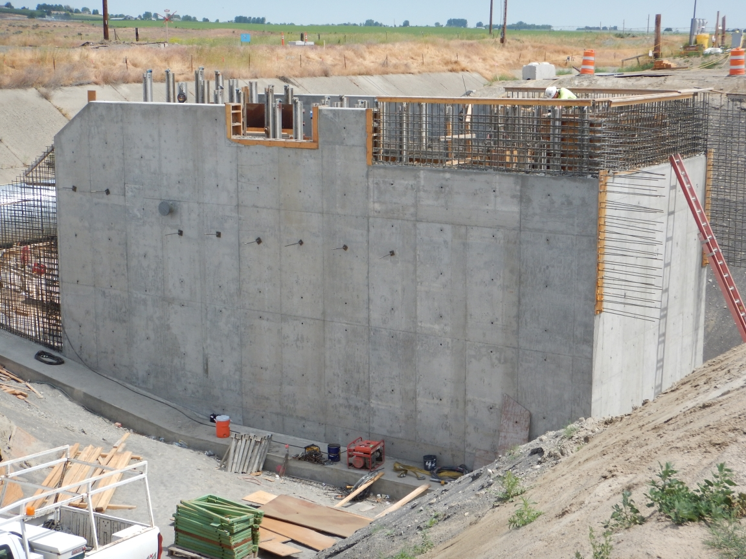
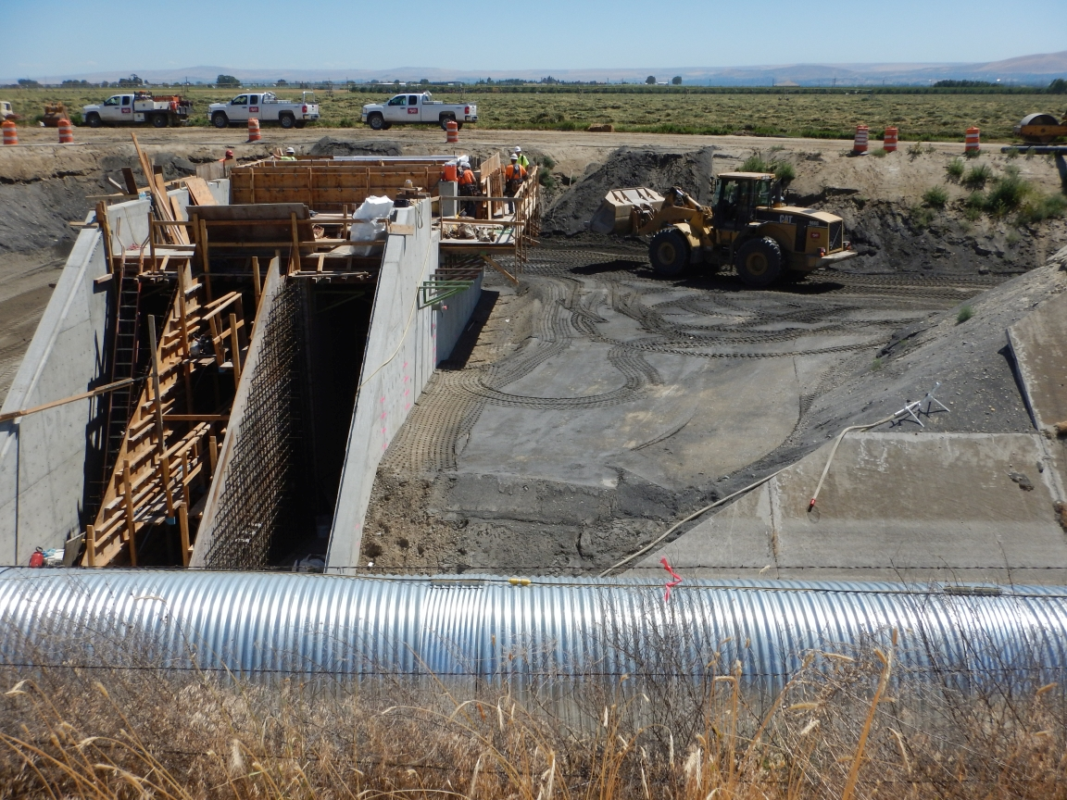

Slide 16
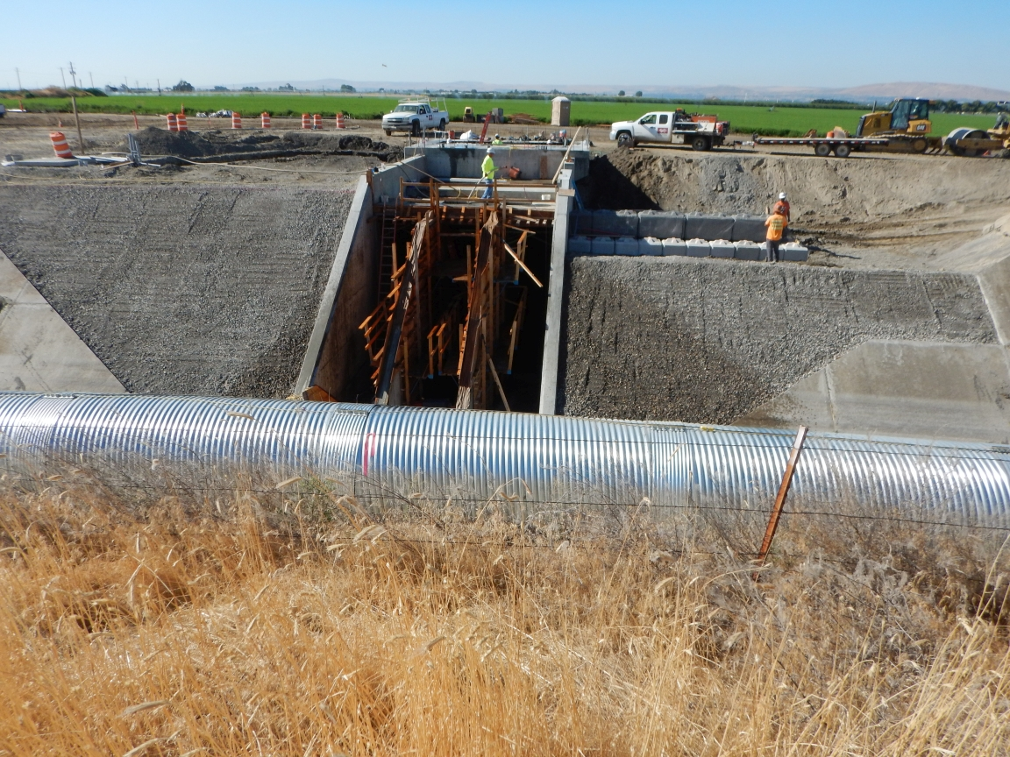
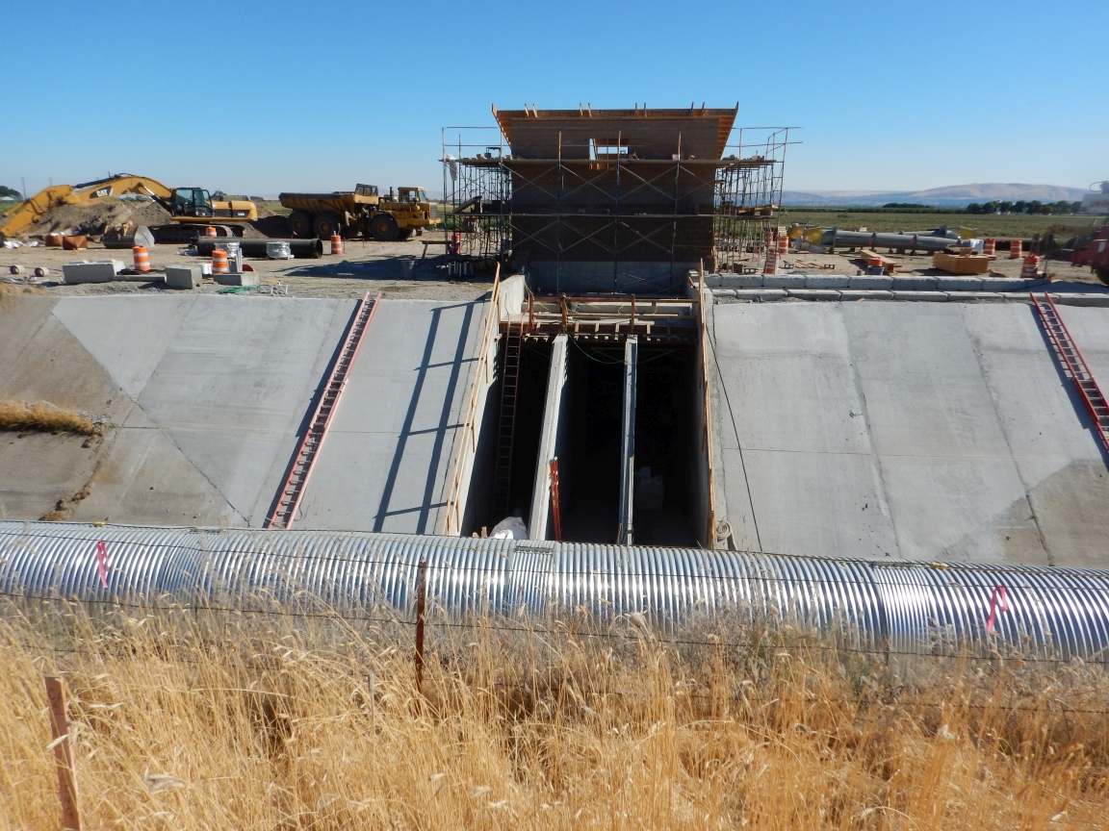
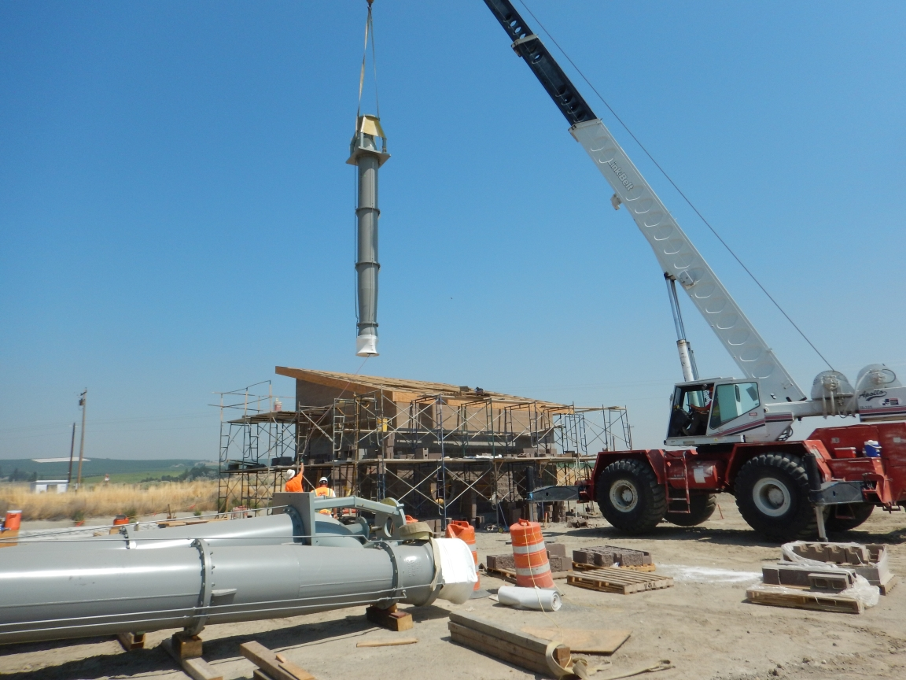

Slide 17
Timeline and Milestones (cont)
Completion Phase
First Pump Operation – 09/12/2017
Systems Commissioning – 10/2017
BPA Approval/Release of Funds – 11/13/2017
Operations Commence – 04/2018
Official Completion Date – 06/08/2018

Slide 18
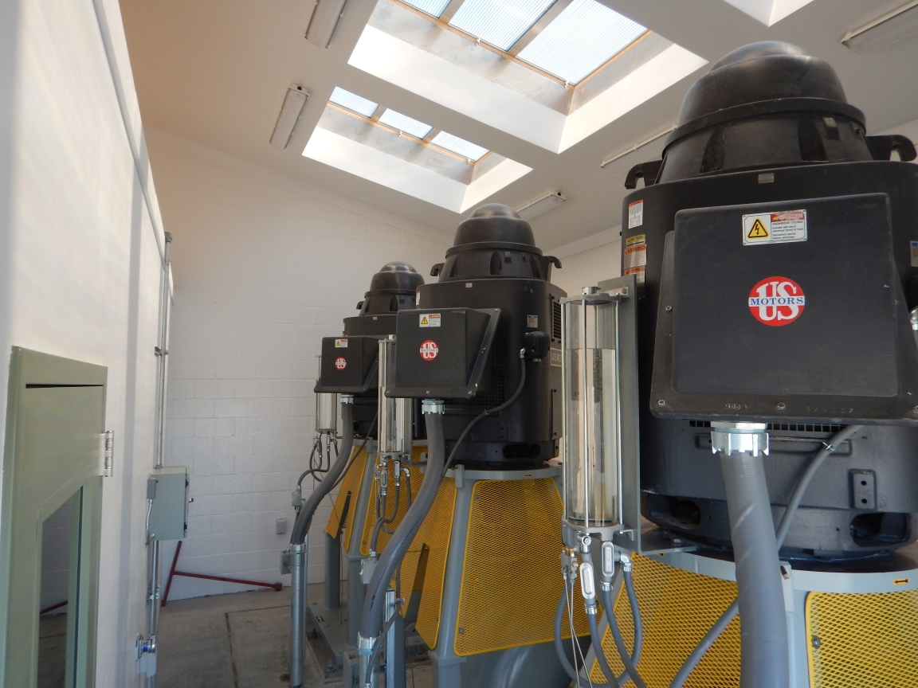
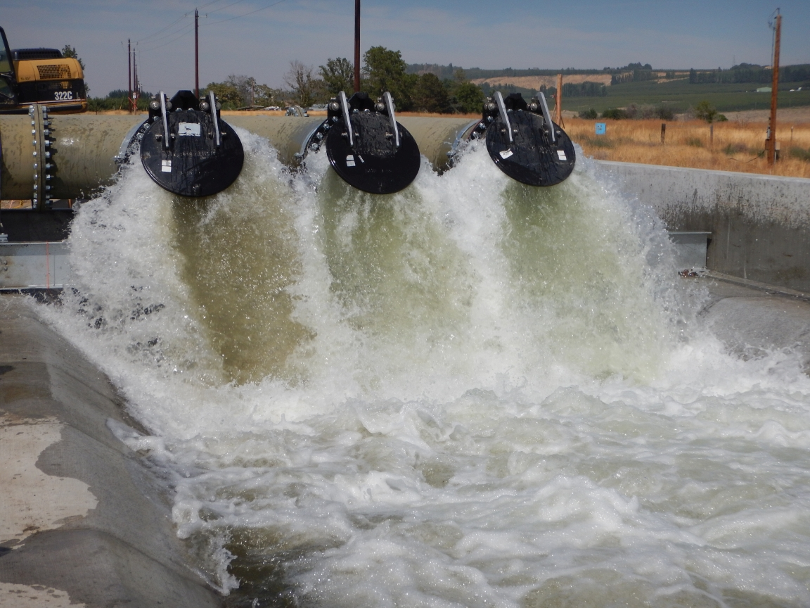
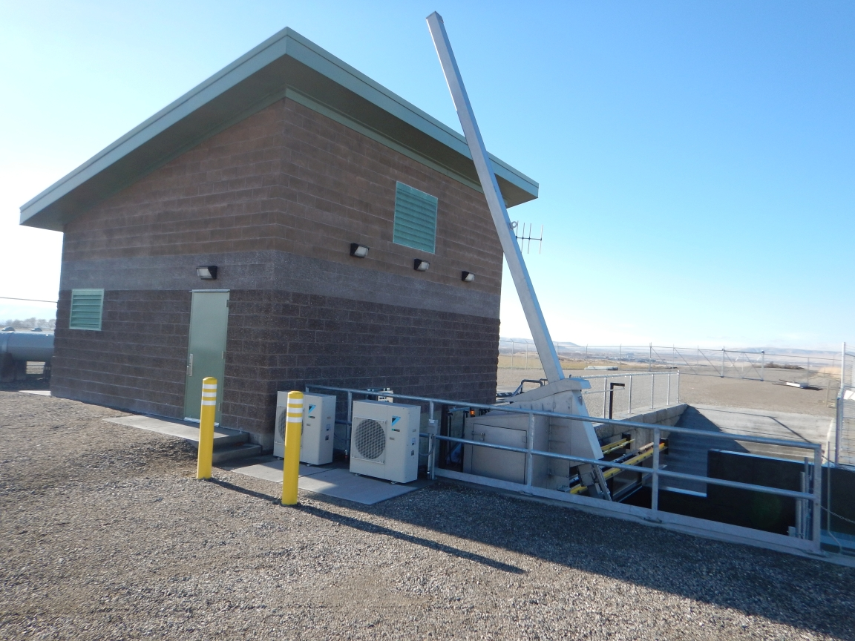
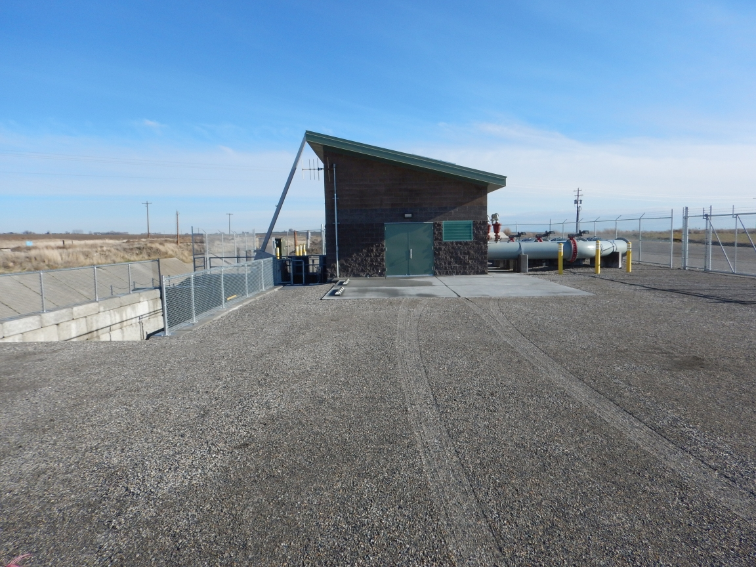

Slide 19
Challenges
BPA Incentive Payment Timeframe
NEPA
Engineering Review
Costs

Slide 20
Questions?
John O’Callaghan
jocallaghan@scbid.org
509-547-1735

