Slide 1
Columbia River Treaty and Office of Columbia River Updates November 1, 2018 / CBDL Conference
G. Thomas Tebb, Director
Ecology – Office of Columbia River

Slide 2
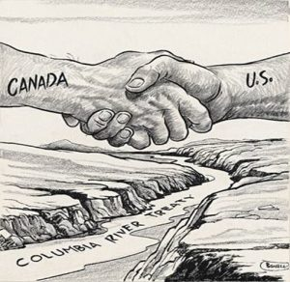
Columbia River Treaty Status Updates

Slide 3
Columbia River System

Slide 4
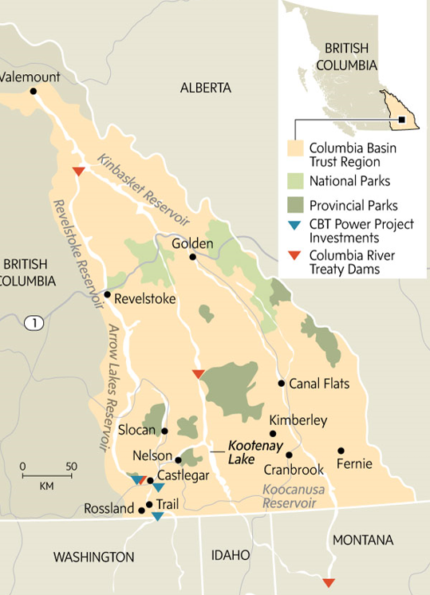
Columbia River - British Columbia

Slide 5
CRT 2013 Regional Recommendations
Calls for:
New formula for calculating the Canadian Entitlement to reflect actual value of coordinated operations
Re-establishing some level of assured flood storage in Canada
Pursuing more coordinated use of Treaty and Non-Treaty storage to increase flexibility/benefits associated with meeting ecosystem based functions, flood risk management, and other authorized water supply purposes in both countries
Providing releases from Canada to promote productive populations of anadromous and resident fish, including flow augmentation operations/incorporating dry year strategy
Establishing domestic processes for resolving issues such as water allocation, flood risk management
https://www.bpa.gov/Projects/Initiatives/crt/CRT-Regional-Recommendation-eFINAL.pdf

Slide 7
CRT Current Status
Circular 175 Negotiating terms completed in October 2017
Secretary Tillerson and Canadian Foreign Minister Freeland met August 2017 – discussed advancing the treaty
British Columbia made regional recommendation to modernize, but Canada has not formally engaged
Important to separate treaty from background noise (NAFTA, Bombardier, soft wood tariffs, class 7 milk pricing)
Circular 175 Negotiating terms completed October 2017
US State Department names Jill Smail new Canadian Treaty negotiator October 2017
Formal negotiations between US and Canada commenced on May 29, 2018 in Washington, DC
Additional negotiations occurred in Nelson, BC on August 15-16, 2018 and on October 17-18 in Portland, OR
Information is available at: https://www.state.gov/p/wha/ci/ca/topics/c78892.htm

Slide 8
Tribal Perspectives - Columbia River
“There is solid, broad-based support among Northwest states, tribes, businesses and citizens to promptly begin formal talks with Canada to modernize the half-century-old Columbia River Treaty for tomorrow’s Northwest,” said Pat Ford, representing Save Our Wild Salmon. “Conservationists and fishermen applaud the State Department for taking this needed step.”
US State Department and Canadian counterparts have agreed to engage with US Tribes and BC First Nations as domestic issues respectively.

Slide 9
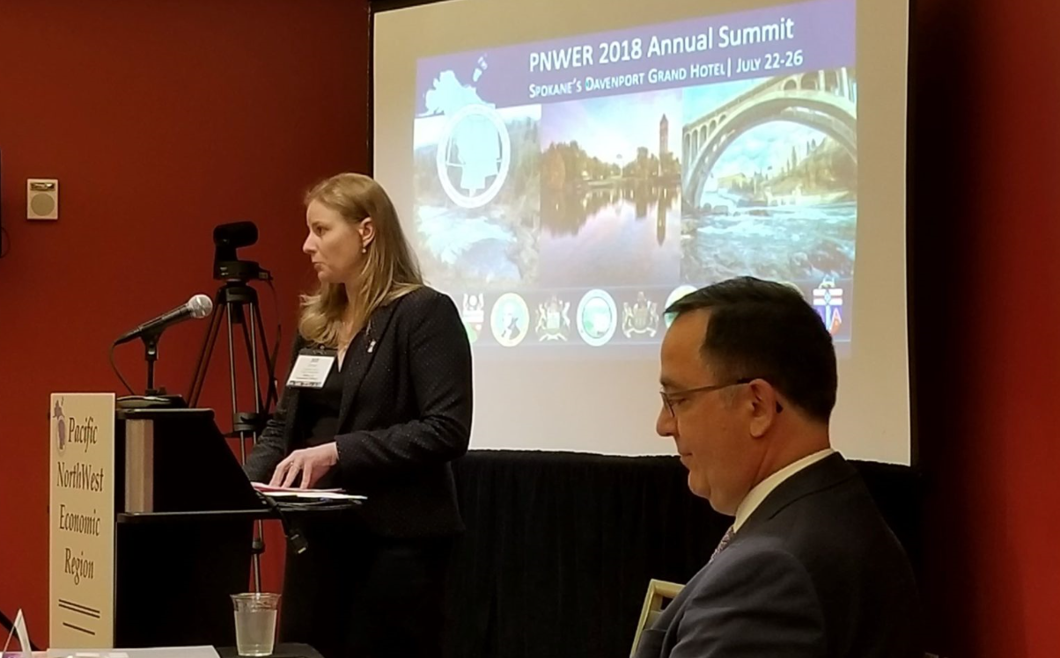
CRT - Town Hall Meeting in Spokane, WA
U.S. State Department, Chief Negotiator Jill Smail and Canadian Counterpart Sylvain Fabi
PNWER Summit July 2018

Slide 10
May 2016 – US District Court of Oregon Decision Regarding Federal Columbia River Power Supply System
US District Court Ruling July 6, 2016:
FCRPS Bi-Op violated Endangered Species Act (ESA)
FCRPS operations also violated ESA
Corps and Reclamation violated NEPA by adopting 2014 Supplemental Bi-Op
Required:
NMFS issue a new Bi-Op by December 31, 2018
BPA, Corps, and Reclamation complete a NEPA EIS on Columbia River System Operations (CRSO) by March 26, 2021 with Record of Decision by September 24, 2021.
EIS must include alternative involving breaching of one or more dams
2018 spill increases

Slide 11
Extra Points Regarding Court Decision, EIS and Proposed Federal Legislation
Four main-stem dams and locks and four lower Snake River dams and locks allow barge passage as far inland as Lewiston, Idaho – would be precluded by dam removal
Water supply alternative being advanced through the CRSO EIS that would account for second half of Columbia Basin Project
Washington State Departments of Agriculture, Ecology, and Fish and Wildlife all cooperating agencies on CSRO EIS
U.S. House Bill 1344 would undo most of the provisions of the court decision

Slide 12
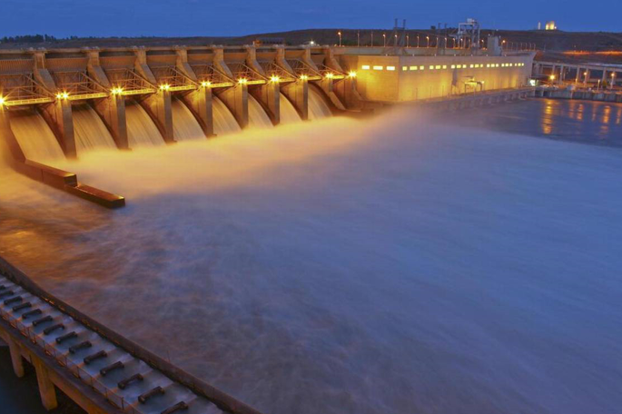
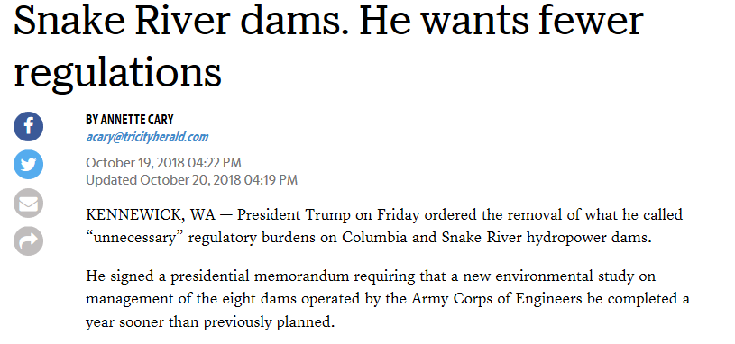

Slide 13
Challenges that Lie Ahead
Supreme Court decisions & legal uncertainties
Columbia River Treaty negotiations
Long-term funding uncertainties
Federal, State and Local
Projects that span multiple biennia (funding, political support)
Investing in aging water supply infrastructure
Climate change, shifting water supplies & drought
Federal Columbia River Power System Biological Opinion (FCRPS BiOP) Uncertainties
Keeping the Momentum going!

Slide 14
Columbia River near Vantage

Slide 15
Conclusion
Any questions?
G. Thomas Tebb, L.H.g, L.E.G.
Email: gteb461@ecy.wa.gov
Phone: (509) 574-3989
Presentation template by SlidesCarnival

