Slide 1
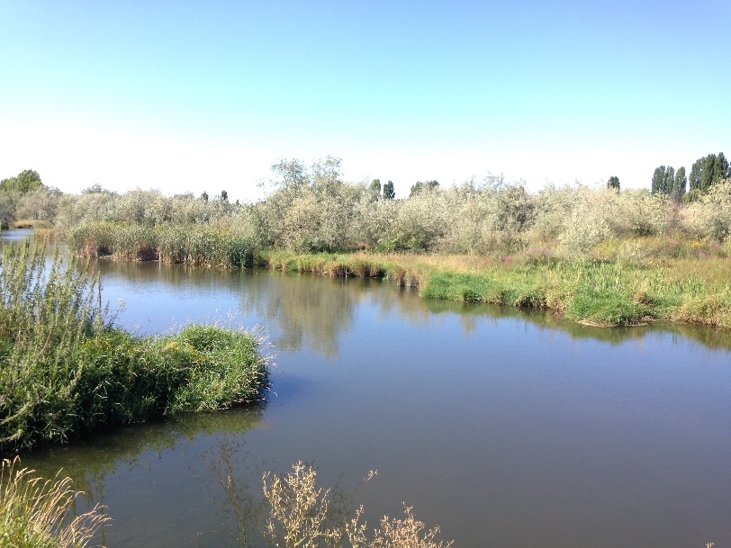
PSFR – What are we doing now to address concerns?
Melissa Downes, Technical & Policy Lead
Ecology, Office of Columbia River
CBDL Conference - November 2, 2017

Slide 2
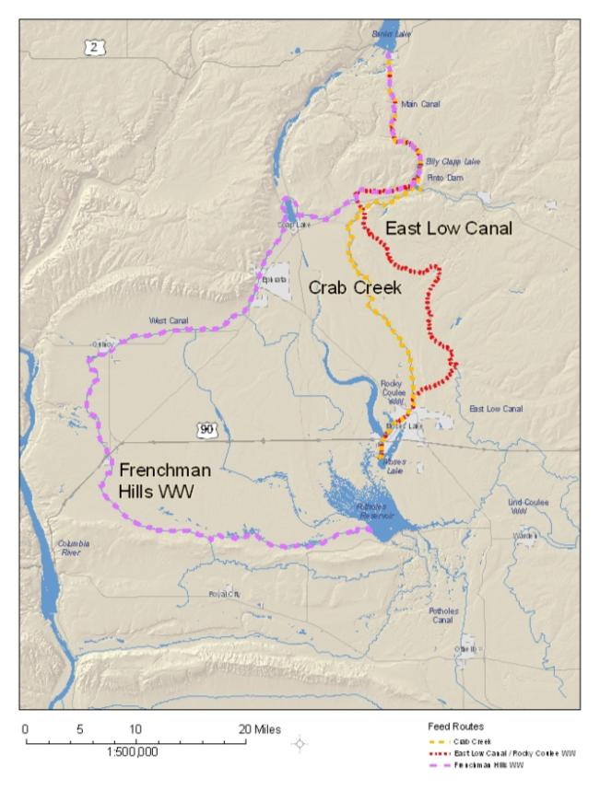
Potholes Supplemental Feedroute

Slide 3
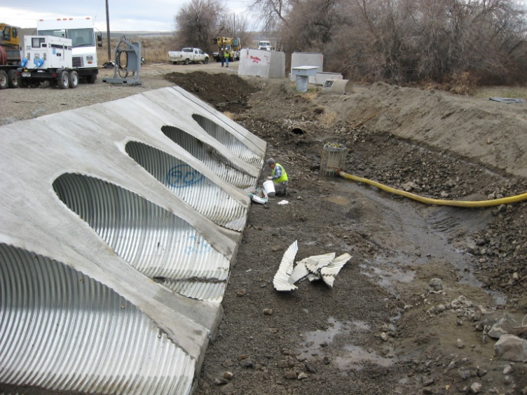
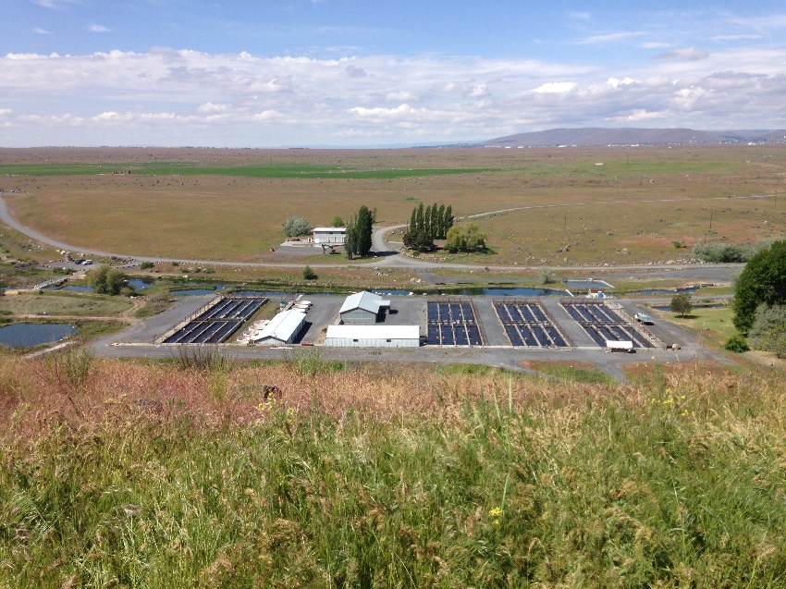
Short Term Actions
Realty and property
transactions
Additional groundwater modeling needs
Grant Co. Airport & ponding
Trout Lodge Fish Hatchery bypass

Slide 4
Long Term Actions
Exploring additional alternatives to convey water from Pinto Dam outlet to Potholes Reservoir
Is mounded waste, seepage and return flow water in the Pasco Basin as supply for SCBID?
This may require a new or supplemental environmental analysis in the future

Slide 5
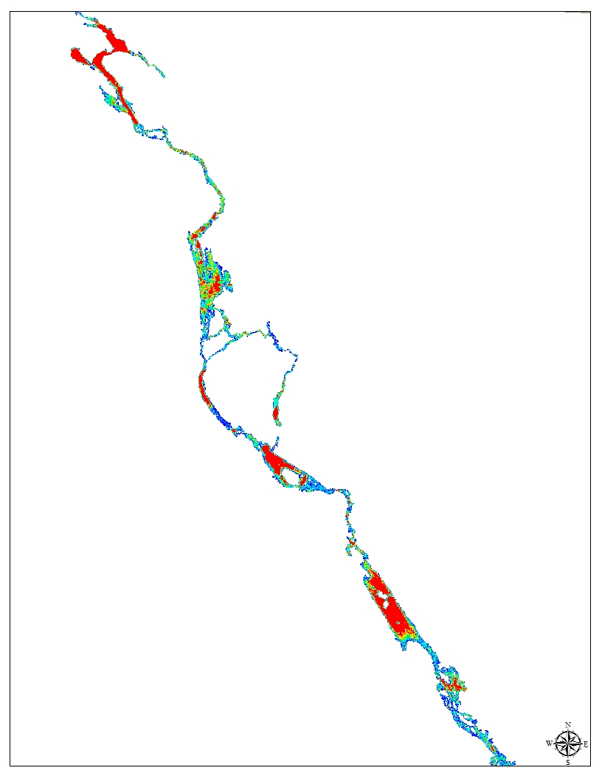
Feedroute Hurdles
Funding
Staff Resources
Future operations & timeline with Odessa delivery systems

Slide 6
Conclusion
Any questions?
Melissa Downes, OCR Ecology
mihi461@ecy.wa.gov
(509) 454-4259
Presentation template by SlidesCarnival

